Slide 1
Mathematics (9-1) - iGCSE
2018-20
Year 09
Goods are packaged in shapes that stack easily on shelves, have space to show the name of the product and attractive pictures, and are not easily knocked over. Packaging also needs to be cheap to produce, and should not leave too much empty space around the item inside.
A manufacturer can choose either a cylindrical box or a cuboid to package 4 tennis balls. Each tennis ball has a diameter of 6.5 cm. Work out the possible dimensions for each box.
Unit 7 – Area and Volume

Slide 2
Contents
Page iv
7 Area And Volume 203
Prior knowledge check 203
7.1 Perimeter and area 204
7.2 Units and accuracy 207
7.3 Prisms 210
7.4 Circles 213
7.5 Sectors of circles 216
7.6 Cylinders and spheres 220
7.7 Pyramids and cones 222
Problem-solving 225
Check up 227
Strengthen 229
Extend 232
Knowledge check 235
Unit test 237

Slide 3
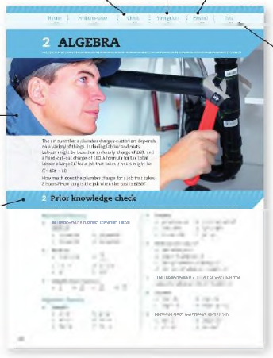
Contents
Page v
At the end of the Master lessons, take a check-up test to help you to decide whether to strengthen or Extend our learning
Extend helps you to apply the maths you know to some different situations
Unit Openers put the maths you are about to learn into a real-life context. Have a go at the question - it uses maths you have already learnt so you should be able to answer it at the start of the unit.
When you have finished the whole unit, a Unit test helps you see how much progress you are making.
Choose only the topics in strengthen thay you need a bit more practice with. You’ll find more hints here to lead you through specific questions. Then move on to Extend
Use the Prior knowledge check to make sure you are ready to start the main lessons in the unit. It checks your knowledge from Key Stage 3 and from earlier in the GCSE course. Your teacher has access to worksheets if you need to recap anything.

Slide 4
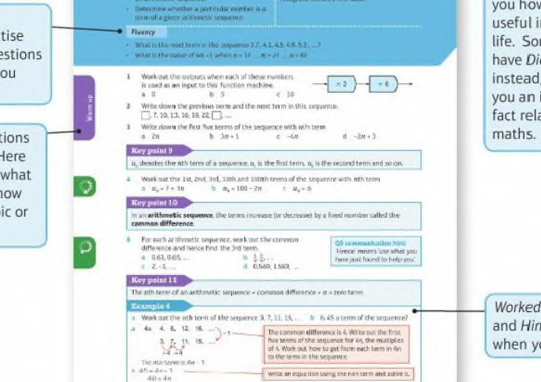
Contents
Page vi

Slide 5
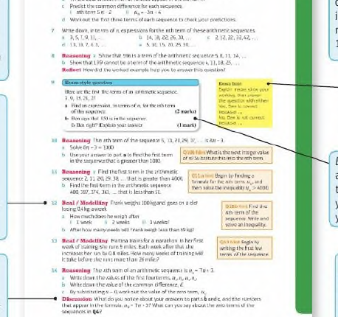
Contents
Page vi

Slide 6
7 – Prior Knowledge Check
Page 203
Numerical fluency
Calculate an estimate for 5.2 x 4.4 x 18.9
Round to 1 decimal place (1 d.p.).
3.57 b. 2.06
4.99
Round to 2 d.p.
9.402 b. 13.9834

Slide 7
7 – Prior Knowledge Check
Page 203
Fluency with Measures
Match each object to the amount of liquid it can hold.
Copy and complete.
5.2m = ◻cm b. 24cm = ◻mm
1m = ◻mm d. 3.41km = ◻m
0.327 litres = ◻ ml
2400ml = ◻ litres
330ml
5ml
5 litres
1l

Slide 8
7 – Prior Knowledge Check
Page 203
Algebraic Fluency
When a = 3, b = 2 and c = 4, work out
2a² b. 4ac + 2b
ab²c d. $\frac{1}{3}$ab
Make x the subject of
y = cx b. a = bxz
m=$\frac{1}{2}$xy

Slide 9
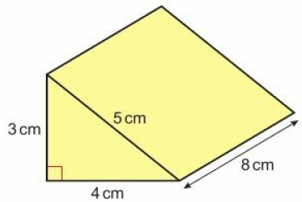
7 – Prior Knowledge Check
Page 203
Geometrical Fluency
Sketch a circle. Draw and label its centre, radius and diameter.
a. Sketch the net of this triangular prism. Label the lengths on your net.
Work out the surface area of the prism.

Slide 10
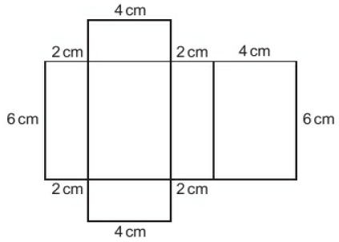
7 – Prior Knowledge Check
Page 204
Geometrical Fluency
a. Sketch the solid formed by this net.
Draw sketches to show its planes of symmetry.
Calculate the volume of the solid.

Slide 11
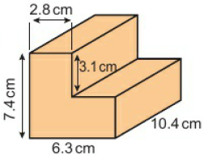
7 – Prior Knowledge Check
Page 204
Geometrical Fluency
Work out the area of this parallelogram.
Work out the volume of this 3D solid. Write your answer to 2 significant figures (2 s.f.).

Slide 12
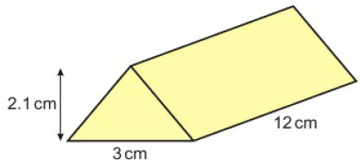
7 – Prior Knowledge Check
Page 204
* Challenge
These chocolate bars are packed into cuboid-shaped boxes for transport. Sketch how you could pack 6 of these bars to take up as little room as possible. What size box do you need for 48 chocolate bars? What other shapes of box could you use to transport them? Which shape box would be most practical?

Slide 13
7.1 – Perimeter and Area
Page 160
Objectives |  | Did You Know?
Find the area and perimeter if compound shapes. Recall and use the formula for area of a trapezium. |  | The name trapezium comes from the Greek word, trapeza, meaning table.
Fluency
Which of these measurements are areas and which are perimeters? 3cm³ 5km 32mm 7m² 46mm² 10cm
ActiveLearn - Homework, practice and support: Higher 7.1

Slide 14
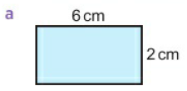
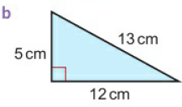
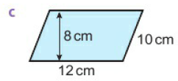
7.1 – Perimeter and Area
Page 204
Work out the area and perimeter of each shape.
Solve:
3x – 12 b. ½x -6
4(x + 2) = 28
Warm Up

Slide 15
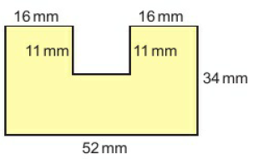
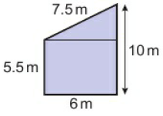
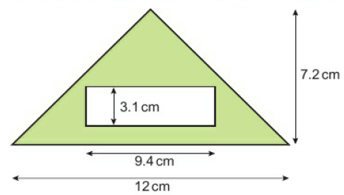
7.1 – Perimeter and Area
Page 205
a. Work out the area and perimeter.
Work out the perimeter
Work out the shaded area. Give your answers to the nearest square mm.
Discussion How did you work out the area in part b? How else could you have done it? Which way is most efficient?

Slide 16
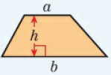
7.1 – Perimeter and Area
Page 205
Key Point 1
This trapezium has parallel sides, a and b, and perpendicular height, h. Two trapezia put together make a parallelogram, with base (a + b) and perpendicular height, h. Area of 2 trapezia = base x perpendicular height = (a + b)h. Area of a trapezium = ½(a + b)h
Communication hint - Trapezia is the plural of trapezium.

Slide 17
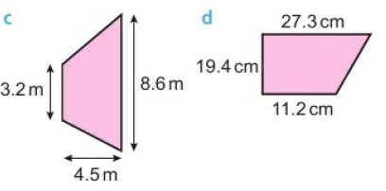
7.1 – Perimeter and Area
Page 205
Calculate the areas of these trapezia. Round your answers to 1 decimal place (1 d.p.) where necessary.
Q4 hint - Use the formula: area = ½(a + b)h

Slide 18
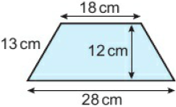
7.1 – Perimeter and Area
Page 206
Calculate the area and perimeter of this isosceles trapezium.
Q5 communication hint - An isosceles trapezium has one line of symmetry. Its two sloping sides are equal.
Reflect How can you remember how to find the area of a trapezium?

Slide 19
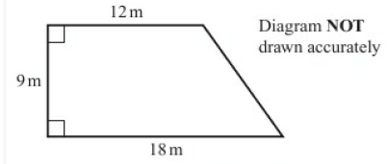
7.1 – Perimeter and Area
Page 206
5 – Exam-Style Questions
Here is a diagram of Jim’s garden.
Jim wants to cover his garden with grass seed to make a lawn.
Grass seed is sold in bags.
There is enough grass seed in each bag to cover 20 m² of garden.
Each bag of grass seed costs £4.99.
Work out the least cost of putting grass seed on Jim’s garden. (4 marks)
Nov 2012, Q25, 1MA0/1F,
Exam hint
Show your working by writing all the calculations you do on your calculator.

Slide 20
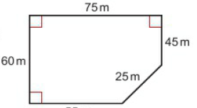
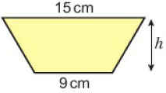
7.1 – Perimeter and Area
Page 206
Problem-solving – Here is the plan of a play area. Work out its area.
The area of this trapezium is 96 cm².
Substitute the values of a, b and A into the formula A = ½(a + b)h
Simplify to get an equation, ◻ = ◻h
Solve to find h.

Slide 21
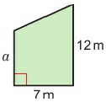
7.1 – Perimeter and Area
Page 206
Problem-solving – A trapezium has area 32cm², and parallel sides 5.5 cm and 10.5 cm. Work out its height.
Q9 strategy hint - Sketch and label the trapezium. Use the method from Q8.
Example 1
This trapezium has area 70m² Find the length of the shorter parallel side. 70 = ½(a + 12) x 7
$\frac{70}{7}$ = 10 = ½(a + 12)
2 x 10 = 20 = a + 12
a = 8 cm
Substitute the values of h, b, and A into the formula A = ½(a + b) h
Divide both sides by 7
Multiply both sides by 2.

Slide 22
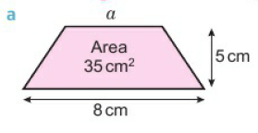
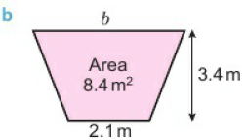
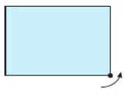
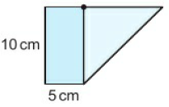
7.1 – Perimeter and Area
Page 207
Reasoning Find the missing lengths,
Problem-solving One corner of a rectangular piece of paper is folded up to make this trapezium. Work out the area of the trapezium.

Slide 23
7.2 – Units and Accuracy
Page 160
Objectives |  | Did You Know?
Convert between metric units of area. Calculate the maximum and minimum possible values of a measurement. |  | The accuracy of a measurement depends on the instrument you measure it with.
Fluency
What is the formula for the area of a square, triangle, rectangle, parallelogram and trapezium? What are the possible values of x when 3 ≤ x ≤ 6 and x is an integer?
ActiveLearn - Homework, practice and support: Higher 7.2

Slide 24
7.2 – Units and Accuracy
Page 207
Round each number to the level of accuracy given.
3.567 (1 d.p.)
320.6 (2 s.f.)
8.495 (2 d.p.)
15.721 (3 s.f.)
Work out
i. 10% of 25 kg ii. 10% less than 25 kg iii. 10% more than 25 kg
i. 5% of 40 m ii. 5% less than 40 m iii. 5% more than 40 m
Warm Up
Q2 all hint - Subtract 10% of 25 kg from 25 kg.

Slide 25
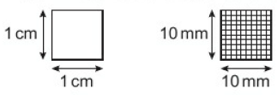
7.2 – Units and Accuracy
Page 207
a. Explain why these two squares have the same area.
Work out the area of each square,
Copy and complete. 1cm² = ◻mm²
Key Point 2
To convert from cm² to mm², multiply by 100.
To convert from mm² to cm², divide by 100.

Slide 26
7.2 – Units and Accuracy
Page 208
Reasoning
Sketch a square with side length 1m and a square with side length 100cm.
Copy and complete. 1m² = ◻cm2
How do you convert from cm² to m²?
Convert
250mm² to cm² b. 5.2 m² to cm²
7000cm² to m² d. 3.4 cm² to mm²
8.85 m² to cm² f. 1246mm² to cm²
0.37 m² to mm²
2 800 000 mm² to m²
Q5g hint - Convert m² to cm²
then to mm².

Slide 27
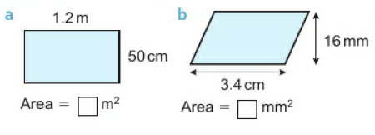
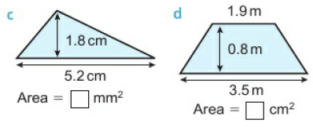
7.2 – Units and Accuracy
Page 208
Calculate these areas.
Reflect In part c, which was the easiest way to find the area in mm²?
Find the area in cm², then convert to mm².
Convert the lengths to mm, then find the area.
Reflect Which was the easiest way to find the area of part d in cm²?

Slide 28
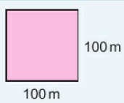
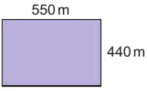
7.2 – Units and Accuracy
Page 208
Key Point 3
1 hectare (ha) is the area of a square 100 m by 100 m.
1 ha = 100 m x 100 m = 10000 m²
Areas of land are measured in hectares.
Here is the plan of a playing field. Work out the area of the field in hectares.

Slide 29
7.2 – Units and Accuracy
Page 208
STEM / Problem-solving A farmer counts 2 wild oat plants in a 50cm by 50cm square of a field. The whole field has area 20 ha. Estimate the number of wild oat plants in the field.
Q8 strategy hint - Work out the area of the square in m². How many of these would fit in the field?
Key Point 4
A 10% error interval means that a measurement could be up to 10% larger or smaller than the one given.

Slide 30
7.2 – Units and Accuracy
Page 208
A factory makes bolts 30 mm long, with a 10% error interval.
Work out the largest and smallest possible lengths of the bolts,
Write the possible lengths as an inequality. ◻ mm ≤ length ≤ ◻ mm
Sweets are packed in 20g bags, with a 5% error interval. Work out the possible masses of the bags of sweets.
Q10 hint - ◻g ≤ mass ≤ ◻g ^

Slide 31
7.2 – Units and Accuracy
Page 209
Reasoning
Each measurement has been rounded to the nearest cm. Write its smallest possible value,
36cm ii. 112cm
Each measurement has been rounded to 1 d.p. Write its smallest possible value,
2.5 cm ii. 6.7 kg
Discussion What is the largest possible value that rounds down to 36 cm?
Key Point 5
Measurements rounded to the nearest unit could be up to half a unit smaller or larger than the rounded value. The possible values of x that round to 3.4 to 1 d.p. are 3.35 ≤ x ≤ 3.45

Slide 32
7.2 – Units and Accuracy
Page 209
Each measurement has been rounded to the accuracy given. Write an inequality to show its smallest and largest possible values. Use x for the measurement,
18 m (to the nearest metre)
24.5 kg (to 1 d.p.)
1.4 m (to 1 d.p.)
5.26 km (to 2 d.p.)
Key Point 5
The upper bound is half a unit greater than the rounded measurement.
The lower bound is half a unit less than the rounded measurement.
12.5 ≤ x ≤ 13.5 lower upper
bound bound

Slide 33
7.2 – Units and Accuracy
Page 209
Write
the lower bound
the upper bound of each measurement,
8 cm (to the nearest cm)
5.3 kg (to the nearest tenth of a kg)
11.4 m (to 1 d.p.)
2.25 litres (to 2 d.p.)
5000 m (to 1 s.f.)
32 mm (to 2 s.f.)
1.53 kg (to 3 s.f.)

Slide 34
7.2 – Units and Accuracy
Page 209
Example 2
The length of the side of a square is 5.34 cm to 2 d.p. Work out the upper and lower bounds for the perimeter. Give the perimeter to a suitable degree of accuracy. 21.34 = 21.3 to 1 decimal place
21.38 = 21.4 to 1 decimal place
21.34 = 21 (nearest cm)
21.38 = 21 (nearest cm)
Perimeter = 21 cm
Use the upper and lower bounds of the side Length to calculate the upper and lower bounds of the perimeter.
 | Lower Bound | Upper Bound
Side Length | 5.335 cm | 5.345 cm
Perimeter | 5.335x4 = 21.34cm | 5.345x4 = 21.38 cm
Round the upper and lower bounds to 1 decimal place. Do they give the same value?
Round to nearest cm. They both give the same value so we can be sure that to the nearest cm, the perimeter is 21 cm.

Slide 35
7.2 – Units and Accuracy
Page 209
Reasoning A rectangle measures 15cm by 28cm to the nearest cm.
Work out the upper and lower bounds for the length and width.
Calculate the upper and lower bounds for the perimeter of the rectangle. Give the perimeter to a suitable degree of accuracy.
Q14 strategy hint - Sketch a diagram. Which two possible lengths will give the largest possible perimeter?

Slide 36
7.2 – Units and Accuracy
Page 210
Reasoning A parallelogram has base length 9.4 m and height 8.5 m. Both measurements are given to 1 d.p. Work out the upper and lower bounds for its area.
Reasoning A parallelogram has area 24cm² to the nearest whole number. Its height is 6.2 cm (to 1 d.p.).
Write the upper and lower bounds for the area and the height,
Work out
upper bound for area upper bound for height
lower bound for area lower bound for height
What is the upper bound for the base of the parallelogram?
Q3 hint - Which calculation in part b gives the higher value?

Slide 37
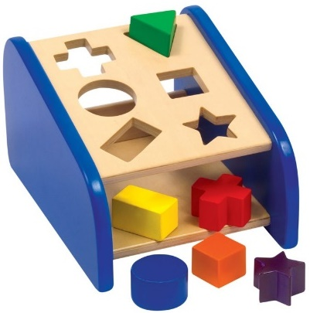
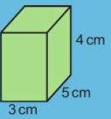
7.3 – Prisms
Page 210
Objectives |  | Did You Know?
Convert between metric units of volume. Calculate volumes and surface areas of prisms. |  | The shapes in a child's shape sorter toy are prisms.
Fluency
Calculate the volume of this cuboid. How could you work out its surface area?
ActiveLearn - Homework, practice and support: Higher 7.3

Slide 38
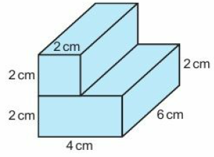
7.3 – Prisms
Page 210
Work out the volume of this 3D solid made from two cuboids.
Solve
9b = 72 b. $\frac{26}{2}$h = 50
Warm Up
Key Point 1
The surface area of a 3D solid is the total area of all its faces.

Slide 39
7.3 – Prisms
Page 210
Reasoning
Sketch a cuboid 4 cm by 5 cm by 7 cm.
Work out the area of the top of your cuboid. Which other face of the cuboid is identical to this one?
Work out the area of the front and side of your cuboid. Which other faces of the cuboid are identical to them?
Work out the total surface area of your cuboid.
Discussion How can you calculate the surface area of a cuboid without drawing its net?
Calculate the surface area of a cuboid 3 cm x 2 cm x 6cm.
Q3 hint – 2 x ◻ + 2 x ◻ + 2 x ◻ = ◻cm²

Slide 40
7.3 – Prisms
Page 211
Key Point 8
A prism is a 3D solid that has the same cross-section all through its length.
Communication
Is the 3D solid in Q1 a prism? Explain your answer
Work out the area of the cross-section of the solid in Q1.
Multiply the area of the cross-section by the Length of the solid. What do you notice?
Discussion For a cuboid, why is multiplying area of cross-section by the length the same as multiplying length x width x height?

Slide 41
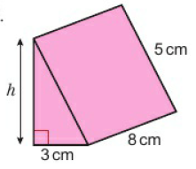
7.3 – Prisms
Page 211
Key Point 9
Volume of prism = area of cross-section x length
Work out the volume of each prism.
Reasoning This triangular prism has volume 48cm³.
Work out its height.
Sketch its net and work out its surface area.
Q7 hint - Write and solve an equation: volume 48 = $\frac{1}{2}$ x h x ◻

Slide 42
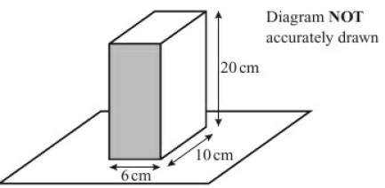
7.3 – Prisms
Page 211
8 – Exam-Style Questions
Jane has a carton of orange juice. The carton is in the shape of a cuboid.
The depth of the orange juice in the carton is 8 cm. Jane closes the carton.
Then she turns the carton over so that it stands on the shaded face.
Work out the depth, in cm, of the orange juice now. (3 marks)
June 2012, Q12, 1MA0/1H
Exam hint
Add the level of the juice to the diagram. Sketch the carton when it stands on the shaded face.

Slide 43
7.3 – Prisms
Page 212
Key Point 9
Volume is measured in mm³, cm³ or m³.
Reasoning
Sketch a cube with side length 1 cm and a cube with side length 10 mm.
Copy and complete. 1cm³ = ◻mm³
How do you convert from mm³ to cm³?
Reasoning
Work out the volumes of a cube with side length 1 m and a cube with side length 100 cm.
How do you convert from m³ to cm³?

Slide 44
7.3 – Prisms
Page 212
Key Point 9
Capacity is measured in ml and Litres.
1cm³ = 1ml 1000 cm³ = 1 litre
Convert
4.5 m³ into cm³
52 cm³ into mm³
9500000 cm³ into m³
3421 mm³ into cm³
5200 cm³ into litres
0.7 litres into cm³
175 ml into cm³
3 m³ into litres.
Q11h hint - Convert 3m³ to cm³ first.

Slide 45
7.3 – Prisms
Page 212
Problem-solving A water tank is a cuboid 140 cm tall, 80cm wide and 2 m long. Kate paints all the faces except the base,
Work out the total area she paints, in square metres,
1 tin of paint covers 4 m². How many tins of paint does Kate need?
Problem-solving / Reasoning - A cube has surface area 507.8 cm² to 1 d.p. What is the length of 1 side of the cube? out the area of 1 face. Give your answer to 1 d.p.
Q12a hint – Sketch the task
Q13 hint – First work out the area of 1 face.

Slide 46
7.3 – Prisms
Page 212
STEM / Modelling A scientist collects a sample of leaf mould 20 cm deep from a 0.25 m² area in a wood.
By modelling the sample as a prism, calculate the volume of leaf mould she collects,
In the leaf mould sample she counts 12 worms. Estimate the number of worms in the top 20cm of leaf mould in 2 hectares of the wood.
Reasoning The dimensions of a cuboid are 5 cm by 3 cm by 8cm, measured to the nearest centimetre. Calculate the upper and lower bounds for the volume of the cuboid.
Q16 strategy hint - First calculate the upper and lower bound of each measurement.

Slide 47
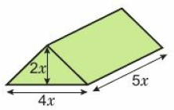
7.3 – Prisms
Page 212
Communication Show that the volume of this prism is 20x³.
Q15 hint - Workout the volume using the measurements in x. Simplify your answer.

Slide 48
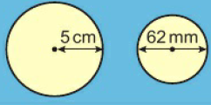
7.4 – Circles
Page 213
Objectives |  | Did You Know?
Calculate the area and circumference of a circle. Calculate area and circumference in terms of IT. |  | Speedometers record the number of revolutions of the wheel and the time taken. They then use the circumference of the wheel to work out the distance travelled in that time, and then the speed.
Fluency
What is the radius of each circle? What is the diameter?
ActiveLearn - Homework, practice and support: Higher 7.4

Slide 49
7.4 – Circles
Page 213
Solve
35 = 7r
75 = 3r²
Make x the subject of
y = mx
t² = x²
p = x²
Warm Up
Key Point 13
The circumference of a circle is its perimeter.

Slide 50
7.4 – Circles
Page 213
Reasoning The table gives the diameter and circumference of some circles.
Work out the ratio circumference for each one. What do you notice? diameter
The ratio $\frac{\text{circumference}}{diameter}$ of a circle is represented by the Greek letter π (pi). Find the π key on your calculator. Write the value of π to 8 d.p.
Discussion How can you workout the circumference of a circle if you know its diameter? What if you know its radius?
Diameter | Circumference
10cm | 31.4cm
54m | 169,6m
36mm | 313mm
Key Point 13
For any circle
circumference = π x diameter
C = πd or C = 2 πr

Slide 51
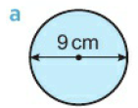
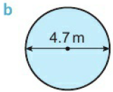
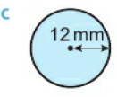
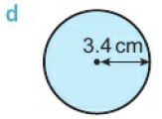
7.4 – Circles
Page 214
Work out the circumference of each circle. Give your answers to 1 d.p. and the units of measurement. Reflect Do you need to remember both formulae for the circumference of a circle, or just one?
Key Point 14
The formula for the area A, of a circle with radium r is A = πr²

Slide 52
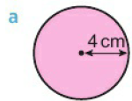
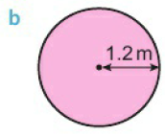
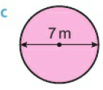
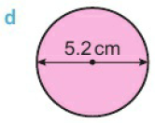
7.4 – Circles
Page 214
Find the area of each circle.
Reflect One of these expressions is for the area of a circle and one is for the circumference. How can you remember which is which?
2πr
πr²
Q6 hint – Think about the units of area and circumference.

Slide 53
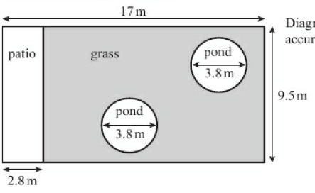
7.4 – Circles
Page 214
7 – Exam-Style Questions
Mr Weaver’s garden is in the shape of a rectangle.
In the garden there is a patio in the shape of a rectangle and two
ponds in the shape of circles with diameter 3.8 m.
The rest of the garden is grass.
Mr. Weaver is going to spread fertiliser over all the g One box of fertiliser will cover 25 m2 of grass.
How many boxes of fertiliser does Mr. Weaver need? You must show your working.
(5 marks)
June 2012, Q5, 1MA0/2H
Exam hint
Show dearly which areas you are working out. You could use:
Area ◻ = Area ○ =

Slide 54
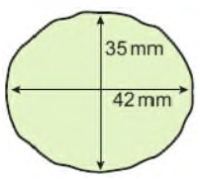
7.4 – Circles
Page 215
STEM / Modelling A biologist needs to estimate the area of this mould sample. She measures the distance across it in two directions,
Work out the mean distance across the sample.
By modelling the sample as a circle, calculate an estimate for its area to the nearest square millimetre.
Q8 hint - Use your mean from part a as an estimate for the diameter.

Slide 55
7.4 – Circles
Page 215
Real / Problem-solving A bicycle wheel has radius 32cm. How many complete revolutions does the wheel make in 1 km?
Reasoning The areas and circumferences of these circles are given in terms of π. Match each circle to its area and circumference.
Q5 communication hint – “In terms of π” means π is the answer.
Q10 hint – Substitute the radius in to the circumference and area formats.

Slide 56
7.4 – Circles
Page 215
Reasoning a. Work out the area and circumference of a circle with radius 6cm
in terms of π
to 2 s.f.
Which values for the area and circumference are the most accurate?
The circumference of a circle is 104cm.
Substitute the value for C into the formula C = πd.
Solve the equation to find the diameter to 1 d.p.
Find the radius of a circle with circumference 24cm.
Q12 hint – C = πd so $\frac{C}{◻}$ = D
Q13 hint – Find the diameter and halve it.

Slide 57
7.4 – Circles
Page 215
Example 3
A circle has area 50m². Find its radius, to the nearest cm. 50 = πr²
$\frac{50}{\text{π}}$ = r²
$\sqrt{\frac{50}{\text{π}}}$ = r
r = 3.99m – 399cm
Substitute A = 50 into the area formula.
Rearrange to make r² the subject.
Square root both sides to find r.

Slide 58
7.4 – Circles
Page 216
a. Find the radius of a circle with area 520 m². Give your answer to the nearest cm.
Find the diameter of a circle with area 630cm². Give your answer to the nearest mm.
Real / Reasoning In a bakery, pastry is rolled into rectangles 0.5 m Circles of diameter 6cm are cut out of the pastry. The remaining pastry is thrown away.
Calculate the area of pastry thrown away from each rectangle,
What percentage of the pastry is thrown away?
Q14b hint – Find the radius and double it.
Q16a hint – How many circles fit across and along the rectangle of pastry?

Slide 59
7.4 – Circles
Page 216
Tim is using circles in a scale diagram. The area of each circle represents the number of people in a group.
Copy and complete to make r the subject of the formula for area of a circle. A = πr² $\frac{A}{◻}$ = r² $\sqrt{\frac{A}{◻}}$ = $◻$
Use your formula for r from part a to work out the radii of circles X, Y and Z to the nearest mm.
Circle | Number of people | Area of circle
X | 40 | 40cm²
Y | 25 | 25cm²
Z | 70 | 70cm²
Q15b communication hint - Radii is the plural of radius.

Slide 60
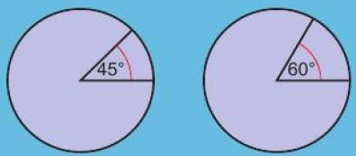
7.5 – Sectors of Circles
Page 216
Objectives |  | Did You Know?
Calculate the perimeter and area of semicircles and quarter circles. Calculate arc lengths, angles and areas of sectors of circles. |  | Half a circle is called a semicircle, but half of a sphere is called a hemisphere. Semi is from the Latin word for half, and hemi is from the Greek word for half.
Fluency
What fraction of the whole circle is each sector.
ActiveLearn - Homework, practice and support: Higher 7.5

Slide 61
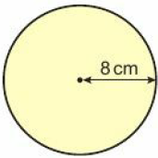
7.5 – Sectors of Circles
Page 216
Find the circumference and area of this circle
In terms of π
Correct to 3 significant figures.
Simplify:
2π + 2π
2π + 6 = 4.2
5 + 3π = 2
Warm Up
Q2b hint – Collect like terms, ◻π + ◻

Slide 62
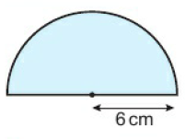
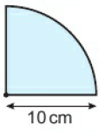
7.5 – Sectors of Circles
Page 217
Work out the area of
the semicircle
the quarter circle
in terms of π
correct to 3 s.f.
Q9f strategy hint - Find the area of the whole circle first.

Slide 63
7.5 – Sectors of Circles
Page 217
Work out the perimeter of each semicircle
in terms of π
to 1 d.p.
Q4 hint - Find half the circumference of the whole circle. Add the diameter to it.

Slide 64
7.5 – Sectors of Circles
Page 217
Work out the perimeter of this quarter circle
in terms of m
to 1 d.p.
Problem-solving A window is made from a rectangle and a semicircle. Work out to 1 d.p.
the area
the perimeter of the window.
Q5 hint - Find one quarter of the circumference of the whole circle. Add two radii to it.
Q6 strategy hint - What is the diameter of the semicircle?

Slide 65
7.5 – Sectors of Circles
Page 217
Problem-solving - Four quarter circles are cut from a 10cm square like this: Work out the shaded area.
The area of this semicircle is 15 cm² to the nearest whole number,
Find the radius of the semicircle. Write all the numbers on your calculator display,
Round your answer to part a to a suitable degree of accuracy.
Discussion What is a suitable level of accuracy?
Q8a strategy hint - Calculate the area of the whole circle, then find its radius.
Q8b hint - How many decimal places could you measure to with a ruler?

Slide 66
7.5 – Sectors of Circles
Page 218
Key Point 1
For a sector with angle x⁰ of a circle with radius r
Arc length = $\frac{x}{360}$ x 2πr Area of sector = $\frac{x}{360}$ x πr²
Communication hint – An arc is part of a circle

Slide 67
7.5 – Sectors of Circles
Page 218
Example 4
Work out:
The arc length b. The perimeter
The area of this sector Give your answers to 3 s.f.
Arc length = $\frac{x}{360}$ x 2πr = $\frac{40}{360}$ x 2 x π x 10 = 6.98cm (3 s.f.)
Perimeter = 6.98 + 10 + 10 = 27.0cm (3 s.f.)
Area = $\frac{x}{360}$ x πr² = $\frac{40}{360}$ x π x 100 = 34.9cm² (3 s.f.)
Write the formula, substitute the angle x and radius
Perimeter = arc length + 2 radii
Write the formula, substitute the angle x and radius

Slide 68
7.5 – Sectors of Circles
Page 218
9 – Exam-Style Questions
OAB is a sector of a circle, centre O.
The radius of the circle is 15 cm.
The angle of the sector is 30°.
Calculate the area of sector OAB.
Give your answer correct to 3 significant figures. (2 marks)
March 2013, Q19, 1MA0/2H
Exam hint
Write the formula you are using and show how you will substitute the given numbers into it. Make sure you write down your unrounded answer on your calculator before rounding.

Slide 69
7.5 – Sectors of Circles
Page 219
Work out the arc length and perimeter of the sector in Q9. Give your answers to 3 s.f.
Problem-solving
Work out the arc length and area of this sector.
The radius of the circle was measured to the nearest cm. Work out the upper and lower bounds for the area of the sector.

Slide 70
7.5 – Sectors of Circles
Page 219
The area of this sector is 10 cm².
Substitute r = 3 and area = 10 into the formula Area = $\frac{x}{360}$ x πr²
Solve your equation from part a to find the angle of the sector, to the nearest degree.
Problem-solving Find the angle of this sector.

Slide 71
7.5 – Sectors of Circles
Page 219
Problem-solving This sector has area 16 m². Find the radius. Give your answer to a suitable degree of accuracy.
Problem-solving Angle AOB is 45°. The sector AOB has area 5π cm². Find the length of the arc AB.
Problem-solving Calculate the area of the shaded region. Give your answer in terms of π.

Slide 72
7.6 – Cylinders and Spheres
Page 220
Objectives |  | Why Learn This?
Calculate volume and surface area of a cylinder and a sphere. Solve problems involving volumes and surface areas. |  | The volume of drink in a can, or the volume of water in a pipe, can be modelled as a cylinder.
Fluency
What is the area and circumference of this circle in terms of π?
ActiveLearn - Homework, practice and support: Higher 7.6

Slide 73
7.6 – Cylinders and Spheres
Page 220
Warm Up
Sketch the net of a cylinder.
Find the value of r. Give answers to 1 decimal place where appropriate.
72 = 2r² b. 54 = $\frac{2}{3}$r³
32 = 4πr² d. 30π = 3πr³
Reasoning A cylinder is a prism.
Write an expression for the area of its cross-section.
Write a formula for its volume.
Q3 hint – V = ◻ x h

Slide 74
7.6 – Cylinders and Spheres
Page 220
Key Point 16
The volume of a cylinder of radius r and height h is V = πr²h
Work out the volume of each cylinder. Give your answer to 1 d.p.

Slide 75
7.6 – Cylinders and Spheres
Page 220
Modelling / STEM A scientist takes a circular section of ice, with diameter 1 m. The mean thickness of the ice is 34cm. Estimate the volume of ice in the sample. Give your answer in m³.
A cylinder has radius 3.5cm and volume 125cm³. Work out its height.
Q5 strategy hint – Draw a diagram
Q6 strategy hint – Substitute the values into the volume formula and solve to find h.

Slide 76
7.6 – Cylinders and Spheres
Page 221
Example 5
Calculate the total surface area of this cylinder. Give your answers to 1 d.p..
Area of each circle = π x 4² = 16π
Area of rectangle = 2πrh = 2 x π x 4 x 8 = 64π
Surface area = 2 x 16π + 64π = 32π + 64π = 96π
= 301.6cm²
Sketch a new.
Each circle has area of πr²
The length if the rectangle is the circumference if the circle, 2πr.
The width of the rectangle is the height of the cylinder, h.
Two circles plus rectangle

Slide 77
7.6 – Cylinders and Spheres
Page 221
Key Point 17
The total surface area of a cylinder of radius r and height h is 2πr² + 2πrh
Calculate the total surface area of each cylinder in Q4.
Problem-solving A cylinder has total surface area 3900mm² and radius 15mm. Work out its height, to the nearest millimetre.
Q8 strategy hint – Substitute the values into the surface area formula and solve.

Slide 78
7.6 – Cylinders and Spheres
Page 221
Problem-solving When 120 cm³ of water is poured into a cylinder, it reaches a height of 8cm. More water is poured into the cylinder, until it reaches a height of 20 cm. How much water is in the cylinder now?
Q9 hint - Work out the radius of the cylinder.
Key Point 17
For a sphere of radius r
Surface area = 4πr²
Volume = $\frac{4}{3}$πr²

Slide 79
7.6 – Cylinders and Spheres
Page 221
Calculate the surface area and volume of each sphere. Give your answers in terms of π.
Real In kitchen cupboards, plastic hemispheres prevent the doors banging when they are closed. A factory produces these hemispheres with diameter 1 cm with a 10% error interval. Work out the possible volumes of plastic used for each hemisphere, to the nearest cubic millimetre.
Q11 hint – ◻mm³ ≤ volume ≤ ◻mm³

Slide 80
7.6 – Cylinders and Spheres
Page 221
12 – Exam-Style Questions
The diagram shows a solid glass paperweight, made from a hemisphere on top of a cylinder.
The height of the cylinder is 20 mm. The radius of the cylinder is 4 mm.
Calculate the total volume of the paperweight. Give your answer correct to 3 significant figures, (3 marks)
Calculate the surface area of the paperweight. Give your answer correct to 3 significant figures.
(3 marks)
Exam hint
Work on each part of the solid separately. Set out your working clearly

Slide 81
7.6 – Cylinders and Spheres
Page 222
Discussion How do you calculate the curved surface area of a hemisphere? Is this the same as the surface area of a hemisphere?
Problem-solving A spherical ball bearing is made from 20 ml of molten steel. Work out its radius, to the nearest millimetre.
Problem-solving What is the radius of a sphere with surface area 500 m²?
Q14 hint – Give your answer to an appropriate level of accuracy.

Slide 82
7.6 – Cylinders and Spheres
Page 222
Problem-solving / STEM - A 10 m long cylinder of brass with radius 2cm is melted down to make a sphere. Work out the radius of the sphere.
Reflect In this Lesson you have used four formulae, for volume and surface area of cylinders and of spheres. How can you remember which is which? Do you need to remember the cylinder formulae or can you work them out using what you know about prisms and circles?
Q15 hint – The two solids have the same volume. Write an equation in terms of it and solve it.

Slide 83
7.7 – Pyramids and Cones
Page 222
Objectives |  |  | Did You Know?
Calculate volume and surface area of pyramids and cones. Solve problems involving pyramids and cones. |  |  | A cone is a pyramid with a circular base.
Fluency
What is the volume of a cube of side 5 mm? A cube has volume 64 cm³. How long is one of its sides?
ActiveLearn - Homework, practice and support: Higher 7.6

Slide 84
7.7 – Pyramids and Cones
Page 222
Work out the angle of each triangle.
Find the length of the sloping side in the triangle in Q1a. Give your answer to 1 d.p.
Warm Up

Slide 85
7.7 – Pyramids and Cones
Page 223
Here is a square-based pyramid. a. Sketch a net of this pyramid,
Work out the area of each face,
Calculate the surface area of the pyramid.
Discussion Do you need to sketch the net to work out the surface area of a pyramid?
Q3 hint - On a square-based pyramid the triangular faces are identical.

Slide 86
7.7 – Pyramids and Cones
Page 223
Key Point 18
Volume of pyramid = $\frac{1}{3}$ area of base x vertical height
Volume of cone = $\frac{1}{3}$ area of base x vertical height
= $\frac{1}{3}$ πr²h
This pyramid has a square base of side 8cm, and vertical height 10 cm. Calculate its volume to 3 s.f.

Slide 87
7.7 – Pyramids and Cones
Page 223
5 – Exam-Style Questions
This solid is made from a square-based pyramid and a cube.
The square-based pyramid is 12 cm high, and has volume 300 cm³.
Find
the length of one side of the square base
the total volume of the solid.
Exam hint
Give your answers to a suitable degree of accuracy.

Slide 88
7.7 – Pyramids and Cones
Page 223
A cone has base radius 6cm and height 8cm. Calculate its volume
in terms of π
to 3 s.f.
Key Point 18
Curved surface area of a cone = πrl, where r is the radius and l is the slant height.
Total surface area of a cone = πrl + πr²

Slide 89
7.7 – Pyramids and Cones
Page 224
A cone has base radius 5 cm and slant height 13 cm. Calculate, in terms of π.
the area of its base
its curved surface area
its total surface area.
Problem-solving / Real Work out the area of card used to make this disposable cup.
Q8 strategy hint - Use Pythagoras to work out the slant height.
Discussion Which value of l gives the most accurate calculation for surface area?

Slide 90
7.7 – Pyramids and Cones
Page 224
Problem-solving Work out the total surface area and volume of a cone with radius 27 mm and vertical height 83 mm.
Problem-solving An ice cream cone of radius 3 cm holds 100 ml of ice cream. What is the height of the cone?
Problem-solving / STEM A sphere of plastic with volume 600cm³ Is melted and used to make a cone of the same radius. Work out the height of the cone.

Slide 91
7.7 – Pyramids and Cones
Page 224
The top 8cm of this cone is cut off, to leave a 3D solid called a frustum. Work out the volume of the frustum, in terms of π.
Calculate the volume of this 3D solid.
Q9f strategy hint - Volume of frustum = volume of whole cone - volume of top cone.

Slide 92
7.7 – Pyramids and Cones
Page 224
This 3D solid is made from a cylinder and a cone.
Write an expression, in mm³, for
the volume of the cylinder
the volume of the cone
the total volume of the solid.
Q13 hint – Convert the heights to mm:
6cm = ◻ mm
x cm = ◻ mm

Slide 93
7 – Problem Solving
Page 225
Objectives
Use a flow diagram to help you solve problems.
Example 6
The diameter of an ice cream scoop must match the diameter of the cone. This is the medium scoop and medium cone.
The medium cone has a vertical height of 17.5cm. A large cone has a vertical height of 18cm. The volume of the large cone is 40% bigger than the medium cone. What diameter scoop should be used for the large cone?
Draw a picture to show all the information in the question. Use your picture to draw a flow diagram.

Slide 94
7 – Problem Solving
Page 225
Example 6
Flow Diagram Working
Answer
d= 2 x 3.5 = 7cm
73.5k = 6πr²
12.25 = r²
3.5 cm = r
$\frac{1}{3}$ x π x r² x 18.
= 6πr² cm²
1.4 x 52.5 π
= 73.5 π cm²
$\frac{1}{3}$ x π x 32 x 17.5
= 52.5πcm2
5
Find the diameter of the large cone
diameter = 2 x radius
Write an equation and solve for r.
4
Find the radius of the large cone
Use the formula for volume of a cone.
Find the volume of the large cone using the formula
3
For an increase of 40%, multiply by 1.4
Find the volume of the large cone using step 1
2
Use the formula for volume of a cone, V = ½πr²h. Leave your answer in terms of πr to save rounding.
1
Find the volume of the medium cone
Start the working here

Slide 95
7 – Problem Solving
Page 226
A football has a diameter of 14.2 cm. The volume of a tennis ball is 10% of the volume of the football. What is the diameter of the tennis ball? Give your answer to 1 decimal place.
A cake recipe requires a round tin with diameter 18cm and height 5cm. The recipe says that the mixture will exactly fill the tin. Renee makes the mixture. Then she realises she only has this tin available: What height does the mixture come to in this tin? Give your answer to 1 decimal place.

Slide 96
7 – Problem Solving
Page 226
The bar chart shows the area taken up by woodland in the UK from 1965 to 2012. What is the percentage increase in area of woodland covering the UK from 1965 to 2012? Give your answer to 3 significant figures.
Q3 hint - Draw a flow diagram. Check when you increase the area of the woodland in 1965 by your answer, you get the area of woodland in 2012.

Slide 97
7 – Problem Solving
Page 226
Finance The diagram shows a tank for storing central heating oil. At the end of the summer, the tank is one quarter full. Work out the cost of filling it for the winter.
Central heating oil
52p per litre + 5% VAT
Delivery charge: up to 1000 litres £25
1000 litres or more £35

Slide 98
7 – Problem Solving
Page 226
A cuboid with a square cross-section sits exactly on top of a regular hexagonal prism to make a 3D solid like this: H marks the middle of the hexagon. M is the midpoint of the side of the square and the side of the hexagonal prism. Find the volume of the 3D solid.
Reflect Did the flow diagrams help you? Is this a strategy you would use again to solve problems? What other strategies did you use to solve these problems?

Slide 99
7 – Check up
Page 227
7. Check up
Log how you did on your Student Progression Chart
2D shapes
Calculate
the area
the perimeter of this isosceles trapezium.
Reasoning The area of this trapezium is 45cm²

Slide 100
7 – Check up
Page 227
a. Calculate the circumference of this circle,
Find the area of the circle in terms of it. Give your answers to 1 d.p.
Work out the perimeter of this semicircle. Give your answer correct to 1 d.p.

Slide 101
7 – Check up
Page 227
Calculate
the area
the arc length of this sector. Give your answers correct to 1 d.p.
Accuracy and measures
Copy and complete.
4m² = ◻cm²
5600cm² = ◻m²
9.5 million cm³ = ◻m³
3 litres = ◻ml = ◻cm³

Slide 102
7 – Check up
Page 227
Ball bearings are manufactured with volume 10cm³, with an error interval of 5%. Write an inequality to show the possible values.
Write an inequality to show the upper and lower bounds of each measurement,
36 m rounded to the nearest metre.
9.2 cm rounded to the nearest mm.
23.6km rounded to 1 d.p.

Slide 103
7 – Check up
Page 228
3D solids
Work out the volume of this triangular prism.
Calculate the surface area of this cylinder, with radius 5.3 cm and height 9.5cm.

Slide 104
7 – Check up
Page 228
A sphere has a radius of 3cm. Work out its colume in terms of π.
Calculate the volume of this cone.
How sure are you of your answers? Were you mostly Just guessing Feeling doubtful Confident
Reflect
☹😐☺

Slide 105
7 – Check up
Page 228
* Challenge
These two cardboard boxes each hold 4 tennis balls, with diameter 6.5 cm. Which shape would you recommend to the manufacturer and why?
Q14 hint - You could think about:
stacking and transport
eye catching design
amount of card needed to make the box
amount of empty space inside, around the tennis balls.

Slide 106
7 – Strengthen
Page 229
7. Strengthen
2D shapes
Find
the vertical height
the perimeter of this trapezium.
Q1a hint - Use a ruler to measure the lengths you need.

Slide 107
7 – Strengthen
Page 229
Reasoning This trapezium has area 55cm²
Substitute the values for A, a and h into the formula A = ½(a + b)h
Simplify the right hand side of your equation from part a. Multiply out the brackets,
Solve the equation to find b.
Work out the circumference of each circle
In terms of π ii. Correct to 1 d.p.
Q2a hint - Copy the diagram and label a, b and h.
Q2a hint - C = πd and C= 2πr If you know the diameter, choose the formula with d in it.
If you know the radius, choose the formula with r in it.

Slide 108
7 – Strengthen
Page 229
Here are two expressions used with circles.
Match each expression to the correct measurement.
Write the formula for area of a circle,
Write the formula for circumference of a circle.
Work out the area of each circle in Q3
in terms of it ii. correct to 1 d.p.
2πr
πr²
Q4 hint - Circumference is in cm. Area is in cm^{[2]},
πr^{[2]} 2πr
Area 34cm²
Circumference 19.5cm
Q5 hint - Substitute the radius into the formula for area. Work out r² but leave it as it is.

Slide 109
7 – Strengthen
Page 230
Here is a semicircle with radius 7cm. Work out, giving your answers to 1 d.p.
the area of a full circle with radius 7 cm
the area of this semicircle with radius 7 cm
the circumference of a full circle with radius 7 cm
the arc length AB
the diameter AB
the perimeter of the semicircle.
Q6b hint - What fraction of a circle is it?

Slide 110
7 – Strengthen
Page 230
What fraction of each circle is shaded?

Slide 111
7 – Strengthen
Page 230
Here is a sector of a circle with radius 8cm.
What fraction of a circle is this sector?
Work out, giving your answers to 1 d.p.
the area of a full circle with radius 8 cm
the area of this sector with radius 8 cm
the circumference of a full circle with radius 8cm
the arc length AB
the total length from A to 0 to 8
the perimeter of the sector.

Slide 112
7 – Strengthen
Page 230
Accuracy and measures
a. Work out the area of each shape in cm².
Copy and complete this double number line for cm² and m².
Q1b hint - Use the areas of the rectangles from part a. Follow the pattern.

Slide 113
7 – Strengthen
Page 231
a. Work out the volume of each cuboid in cm³.
Copy and complete this double number line for cm³ and m³.
Pencils are made 25cm long, with an error interval of 10%.
Work out 10% of 25.
Work out 25 + 10% and 25 - 10%.
Write an inequality to show the possible values,

Slide 114
7 – Strengthen
Page 231
a. A pen is 23 cm long, to the nearest cm. The diagram shows the measurements that round to 23 cm, to the nearest cm. Write an inequality to show the upper and lower bounds of this measurement. Use L for the length of the pen.
A pencil sharpener is 32mm long, to the nearest mm. Write an inequality to show the upper and lower bounds of this measurement. Use l for the length of the pencil sharpener,
Q4b hint - Draw a diagram, like the one in part a.

Slide 115
7 – Strengthen
Page 231
3D Solids
Work out the vo lume of these prisms by
working out the area of the front face
multiplying the area by the length of the prism.
Q1 hint - Sketch the front face to help you work out its area.

Slide 116
7 – Strengthen
Page 231
a. Sketch the net of this cylinder.
Work out (giving your answers to 1 d.p.)
the area of the circle
the length of the rectangle
the area of the rectangle
the total surface area of the cylinder.
Q2bii hint - The rectangle face wraps right round the circle. Circumference =2πr.

Slide 117
7 – Strengthen
Page 232
Here are two expressions used with spheres.
Match each expression to the correct measurement
Write the formula for surface area of a sphere,
Write the formula for volume of a sphere,
For this sphere, workout
the surface area
the volume.
Give your answers to 2 d.p.
4πr²
$\frac{4}{3}$πr²
volume = 340cm³
surface area = 746cm²

Slide 118
7 – Strengthen
Page 232
Here is a cone.
What is its vertical height?
What is its slant height?
Use the formula to work out the volume of the cone.
V = $\frac{4}{7}$ πr2h where h is vertical height
Use the formula to work out the surface area of the cone.
Surface area = πr² + πrl, where l is the slant height.
Give your answer correct to 1 d.p.

Slide 119
7 – Extend
Page 232
7. Extend
1 – Exam-Style Questions
QT = 5cm
RS = 10 cm
TS = 11cm
Work out the area of the trapezium TQRS (2 marks)
Exam hint - Write down the formula for finding its area before substituting in the measurements.

Slide 120
7 – Strengthen
Page 233
Write an expression for
the area of the cross section of this prism in mm²
the volume of the prism in mm³.
Problem-solving The diagram shows a lawn with a wall along one side.
Show clearly that the wall is 4 m long,
A 500 ml bottle of lawn feed treats 20 m2 of lawn. How many bottles are needed to treat this lawn?
Q3a hint - Split the shape into a rectangle and a right-angled triangle. Use Pythagoras.

Slide 121
7 – Strengthen
Page 233
STEM The graph shows the velocity of a remote-controlled car during a test. Work out the distance the car travelled during the test.
Problem-solving / Real A cylindrical water tank has height 1.2 m and radius 50cm. Water flows into the tank at a rate of 300 ml per second. How long will it take for the tank to fill? Give your answer to the nearest minute.
Q4 hint - Distance = area under velocity -time graph.

Slide 122
7 – Strengthen
Page 233
Sketch three copies of this net for a triangular prism.
On one net, shade an area given by the expression ax.
On the second net, shade an area given by the expression (a + b)x.
On the third net, shade an area given by the expression ½bc.
Q6b hint – Expand the brackets.

Slide 123
7 – Strengthen
Page 234
Problem-solving The diagram shows an isosceles trapezium Calculate
The height
the area of the trapezium.
Q6b hint – Find x using sin 60⁰

Slide 124
7 – Strengthen
Page 234
Problem-solving The diagram shows a trapezium. All the lengths are in centimetres. The area of the trapezium is 144cm². Show that 3 x 2 - 6x = 144
Problem-solving A paintbrush is 30cm long. It just fits diagonally inside a cylindrical paint tin. The tin is 24 cm high. What is the capacity of the tin, to the nearest litre?
Q8 hint - Substitute the measurements given into the formula for area of a trapezium.
Q9 hint - Sketch the tin. rind the diameter, then the radius.

Slide 125
7 – Strengthen
Page 234
10 – Exam-Style Questions
The diagram shows a solid metal cylinder.
The cylinder has base radius 2x and height 9x.
The cylinder is melted down and made into a sphere of radius i Find an expression for r in terms of x. (3 marks)
June 2012, Q25, JMA0/1H
Exam hint
Write down the volume formula before you substitute the given lengths into it.

Slide 126
7 – Strengthen
Page 234
x = 15.6 y = 4.2 z = 5.8 All values have been rounded to 1 d.p. Work out the upper bounds of
x+y b. yz c. xyz d. $\frac{x}{y}$
d = 520 (2 s.f.) e = 13.8 (3 s.f.) Work out the lower bounds of
d + e b. d² c. $\frac{d}{e}$
STEM The diameter of the moon is 3.5 x 106 metres. Calculate its surface area. Assume the moon is a sphere.
Q13 hint - Give your answer in standard form.

Slide 127
7 – Knowledge Check
Page 235
7. Knowledge Check
Area of a trapezium = Ua + b)h To convert from cm2 to mm2, multiply by 100. To convert from mm2 to cm2, divide by 100 1 hectare (ha) is the area of a square 100 m by 100 m. 1 ha = 100 m x 100 m = 10000 m2 A10% error interval means that a measurement could be up to 10% larger or smaller than the one given. Measurements rounded to the nearest unit could be up to half a unit smaller or larger than the rounded value. The possible values of x that round to 3.4 to 1 d.p. are 3.35 ≤ x < 3.45
Mastery Lesson 7.2
Mastery Lesson 7.2
Mastery Lesson 7.2
Mastery Lesson 7.2
Mastery Lesson 7.2

Slide 128
7 – Knowledge Check
Page 235
7. Knowledge Check
The upper bound is half a unit greater than the rounded measurement. The lower bound is half a unit less than the rounded measurement 12.5 ≤ x < 13.5 lower bound upper bound When giving the answer to a calculation to an appropriate degree of accuracy, round the upper and lower bounds by the same amount. If the upper and lower bound give the same value when rounded, then the answer is to an appropriate degree of accuracy. Volume is measured in mm3, cm3 or m3 Capacity is measured in ml and litres. 1 cm³ = 1 ml, 1000 cm³ = 1 litre The surface area of a 3D solid is the total area of all its faces.
Mastery Lesson 7.2
Mastery Lesson 7.2
Mastery Lesson 7.3
Mastery Lesson 7.3

Slide 129
7 – Knowledge Check
Page 235
7. Knowledge Check
A prism is a 3D solid that has the same cross-section all through its length. Volume of a prism = area of cross section x length The circumference of a circle is its perimeter. For any circle circumference = it x diameter C = πd or C= 2πr The formula for the area. A, of a circle with radius r is A =πr² The volume of a cylinder of radius rand height A is V = πr²h
Mastery Lesson 7.3
Mastery Lesson 7.3
Mastery Lesson 7.4
Mastery Lesson 7.4
Mastery Lesson 7.6

Slide 130
7 – Knowledge Check
Page 236
7. Knowledge Check
The surface area of a cylinder of radius r and height h is 2πr² + 2πrh For a sphere of radius r surface area = 4πr² volume = $\frac{4}{3}$ πr³ Volume of pyramid = $\frac{1}{3}$ area of base x vertical height Volume of cone = $\frac{1}{3}$ area of base x vertical height = $\frac{1}{3}$πr²h
Mastery Lesson 7.6
Mastery Lesson 7.6
Mastery Lesson 7.7

Slide 131
7 – Knowledge Check
Page 236
7. Knowledge Check
Curved surface area of a cone = πrl, where r is the radius and l is the slant height. Total surface area of a core = πrl + πr². Look back at this unit. Which lesson made you think the hardest? Write a sentence to explain why. Begin your sentence with, ‘Lesson _______ made me think the hardest because _____________.’
Mastery Lesson 7.7
Mastery Lesson 7.7
Reflect

Slide 132
7 – Unit Test
Page 237
7. Unit Test | Log how you did on your Student Progression Chart
14 – Exam-Style Questions
A circle has a diameter of 140 cm.
Work out the circumference of the circle.
Give your answer correct to 3 significant figures. (2 marks)
Nov 2013, Q12, 1MA0/2H
Reasoning Workout
the area
the perimeter of this trapezium.
(4 marks)

Slide 133
7 – Unit Test
Page 237
Reasoning A trapezium of area 60cm² has parallel sides of length 12cm and 8cm. What is the distance between the two parallel sides? (3 marks)
Reasoning A cylindrical water tank holds 26 litres when full. The water tank is 36cm tall. Work out the radius of the tank to 2 d.p. (4 marks)
Reasoning This triangular prism has volume 6720cm³. Work out
the length of the prism
its surface area. (5 marks)

Slide 134
7 – Unit Test
Page 237
Reasoning a. What is the area of a circle with radius 8cm? Give your answer in terms of it.
Dan draws a circle with double the area of the circle in part a. What radius does he use? Give your answer to a suitable degree of accuracy. (3 marks)
Reasoning Calculate the perimeter of this shape. Give your answer to 3 s.f. (2 marks)
Calculate the surface area of a sphere of radius 5.6cm. Give your answer to 3 s.f. (2 marks)

Slide 135
7 – Unit Test
Page 237
This solid is made from a cone and a cylinder of radius 4cm. Find the total surface area of the solid, including the base, in terms of πr. (4 marks)
Find the angle of this sector. (3 marks)
The lengths of this square-based pyramid are given to 1 d.p. Calculate the upper and lower bounds for its volume. (3 marks)

Slide 136
7 – Unit Test
Page 237
Sample student answer
Why will the student only get 1 mark for this answer?
Student Answer
$\frac{150}{360}$ x π x 132 = 221.2cm²
12 – Exam-Style Questions
The diagram shows a sector of a circle, centre 0. The radius of the circle is 13 cm.
The angle of the sector is 150°.
Calculate the area of the sector.
Give your answer correct to 3 significant figures. (2 marks)
June 2008, Q19. 5540/4H

